Slide 1



DIGITAL PORTFOLIO
STUDENT NAME: ANGEL.M
REGISTERNO AND NMID:98803B124E415C4A35D4A527D1EAD7DC
DEPARTMENT:B CA
COLLEGE/UNIVERSITY :GLOBAL COLLEGE OF ARTS AND SCIENCE/THIRUVALLUVAR UNIVERSITY

Slide 2
PROJECT TITLE
SALOON PORTFOLIO
USING FRONT END DEVELOPMENT

Slide 3
AGENDA
1.Problem Statement
2.Project Overview
3.End Users
4.Tools and Technologies
5.Portfolio design and
Layout
6.Features and Functionality
7.Results and Screenshots
8.Conclusion
9.Github Link

Slide 4
PROBLEM STATEMENT
Traditional salons rely mostly on offline promotion, which limits their customer reach and bookings. A digital portfolio website is needed to showcase services, display work, and provide easy online appointment booking for clients.

Slide 5
WHO ARE ALL END USERS
Customers – seeking salon services like hair, makeup, spa, and beauty care.
Brides & Grooms – booking professional styling and makeup.
Event Attendees – preparing for parties, functions, or special occasions.
Salon Staff & Management – managing appointments and showcasing services.

Slide 6
TOOLS AND TECHNIQUES
HTML5 – to structure the website.
CSS3 – for styling, layout, and responsive design.
JavaScript – for form handling and interactivity.
Font Awesome – for icons.
Responsive Design Techniques – to ensure compatibility on all devices.

Slide 7
TECHNIQUES APPLIED
Responsive Web Design for desktop, tablet, and mobile.
Grid and Flexbox Layouts for organized content.
Hover Effects & Transitions on gallery images and service cards.
Form Validation & JavaScript Alerts for booking confirmation.
Sticky Navigation & Smooth Scrolling for better user experience.

Slide 8
PORTFOLIO DESIGN AND LAYOUT
The salon portfolio has a clean, modern, and responsive layout with sections for About, Services, Gallery, and Contact. It uses grid and card layouts for easy navigation and visually appealing presentation.

Slide 9
FEATURES AND FUNCTIONALITIES
Responsive design for all devices.
About section showcasing the salon.
Services section with detailed offerings.
Gallery displaying hairstyles, makeup, and spa treatments.
Contact & booking form for appointments.
Social media integration (Facebook, Instagram, WhatsApp).

Slide 10
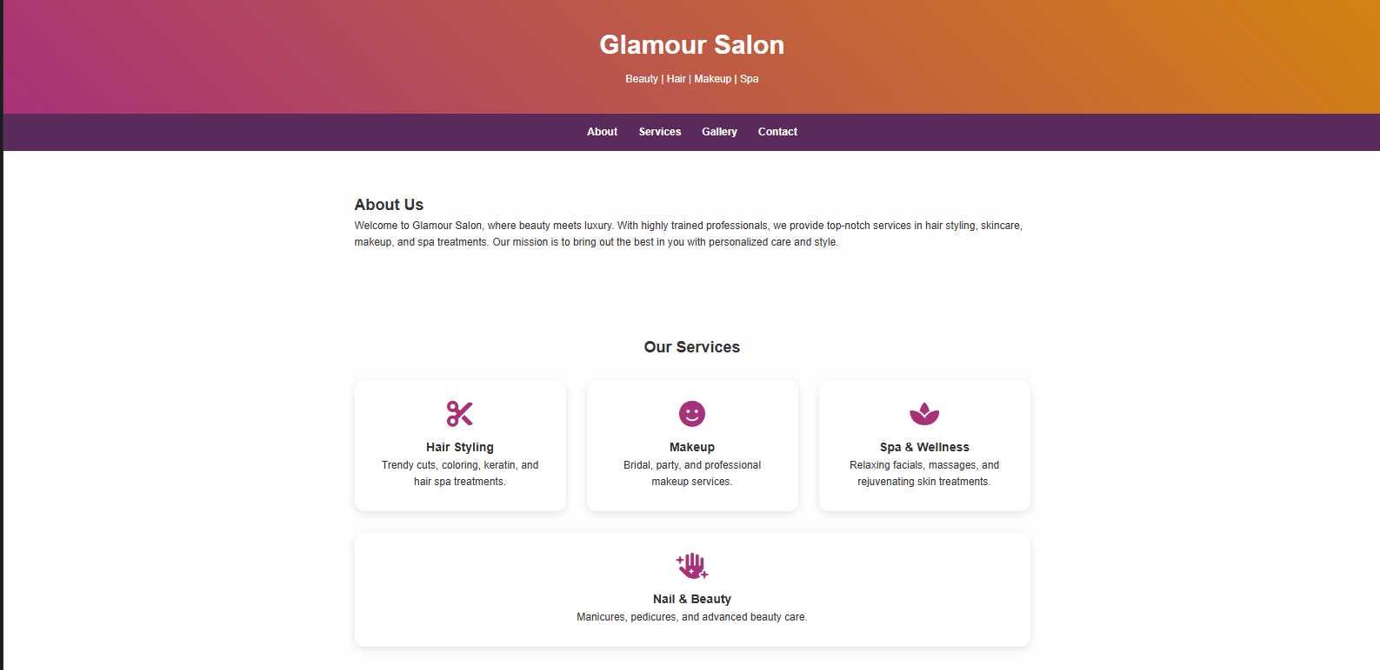
RESULTS AND OUTPUT

Slide 11
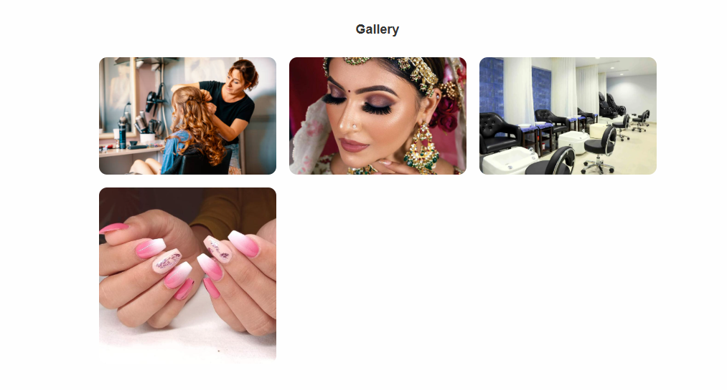

Slide 12
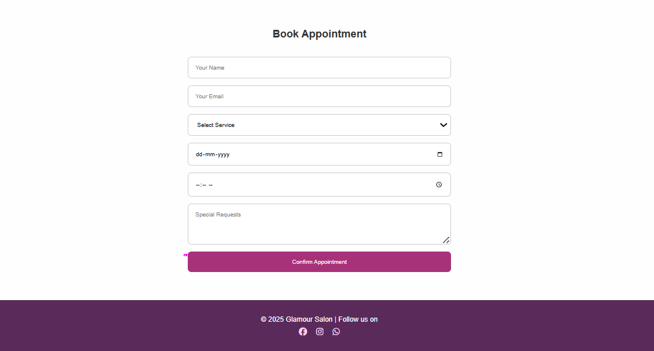

Slide 13
CONCLUSION
The Salon Digital Portfolio provides a professional online presence, showcasing services, gallery, and contact options. It helps attract clients, simplifies appointment booking, and enhances the salon’s visibility and credibility.

